Slide 1

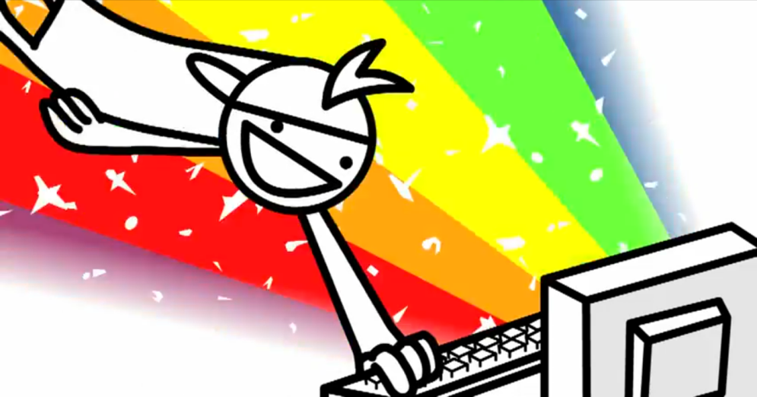
User Experience
UI, UX and Behaviors
SUPINFO Official Document
© asdf
Notes:
© SUPINFO International University - http://www.supinfo.com
SUPINFO vous permet de partager ce document
Vous êtes libre de :
Partager — reproduire, distribuer et communiquer ce document Remixer — modifier ce document
A condition de respecter les règles suivantes :
Indication obligatoire de la paternité — Vous devez obligatoirement préciser l’origine « SUPINFO » du document au début de celui-ci de la même manière qu’indiqué par SUPINFO International University – Notamment en laissant obligatoirement la première et la dernière page du document, mais pas d'une manière qui suggérerait que SUPINFO International University vous soutiennent ou approuvent votre utilisation du document, surtout si vous le modifiez. Dans ce dernier cas, il vous faudra obligatoirement supprimer le texte « SUPINFO Official Document » en tête de page et préciser notamment la page indiquant votre identité et les modifications principales apportées.
En dehors de ces dispositions, aucune autre modification de la première et de la dernière page du document n’est autorisée.
NOTE IMPORTANTE : Ce document est mis à disposition selon le contrat CC-BY-NC-SA Creative Commons disponible en ligne http://creativecommons.org/licenses ou par courrier postal à Creative Commons, 171 Second Street, Suite 300, San Francisco, California 94105, USA modifié en ce sens que la première et la dernière page du document ne peuvent être supprimées en cas de reproduction, distribution, communication ou modification. Vous pouvez donc reproduire, remixer, arranger et adapter ce document à des fins non commerciales tant que vous respectez les règles de paternité et que les nouveaux documents sont protégés selon des termes identiques. Les autorisations au-delà du champ de cette licence peuvent être obtenues à support@supinfo.com.
© SUPINFO International University – EDUCINVEST - Rue Ducale, 29 - 1000 Brussels Belgium . www.supinfo.com

Slide 2

Objectives
User Experience
By completing this course, you’ll be able to:
Understand what are UI and UX
Explain differences and goals of each
Analyze UX of a service and create one
Understand meaning of behavior analyze
Enumerate and use some popular designs

Slide 3


Course plan
User Experience
Introduction
What are UI & UX?
Dive into UX
User Behaviors
Good Practices

Slide 4

Introduction
User Experience

Slide 5

General purpose
Introduction
More and more websites everyday
Various purposes
Various subjects
Various users browsing
Linked by HyperTexts = Easily findable
All have in common a display for users

Slide 6
Displaying content
Introduction
Important to know how to display content
Key to success
Translated into jobs nowadays
Without this skill, users may run away
So how to please your visitors?
That’s what this course is about
Notes:
« Any of you have an example for running away when it’s not easy to use? »
http://www.e-naxos.com/Blog/post/Le-Syndrome-de-la-porte-de-Parking.aspx

Slide 7

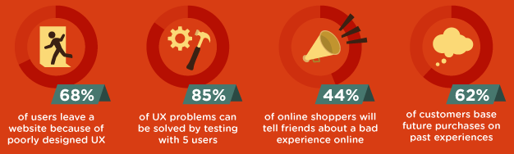
Some statistics
User Behaviors
Source: http://www.homestead.com/
Notes:
http://www.homestead.com/blog/06/2013/ux-101-what-user-experience-infographic#.UriajvRDs1K

Slide 8
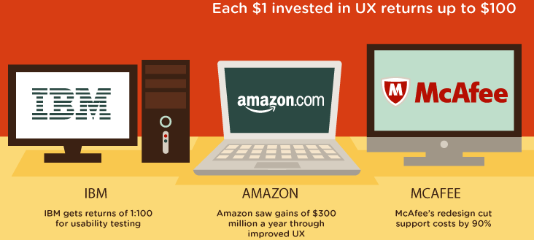
Some statistics
User Behaviors
Source: http://www.homestead.com/
Notes:
http://www.homestead.com/blog/06/2013/ux-101-what-user-experience-infographic#.UriajvRDs1K

Slide 9
Several jobs
Introduction
Information architect:
Focus on ease of use, workflows
Make it easier to reach the purpose of the product
Interaction designer:
Focus on how to use controls naturally
For example, invent pinch to zoom
Notes:
Do NOT forget to define workflows!
Here is a simple definition:
Workflows defines a list of steps linked each others to achieve a goal. Steps may be concurrent or wait for the previous one to finish. In an ecommerce website, the workflow « Buy a product » might take several steps, like « View a product », « Put it in the cart », « Go to the payment area », « Define the user (name, address, etc) », « Pay for the product », « Receive a bill now and the product later ».
http://www.journaldunet.com/solutions/expert/53783/ux-designer--ergonome--architecte-de-l-information--designer-d-interaction------quelle-difference.shtml

Slide 10
Several jobs
Introduction
Ergonomist:
Focused on efficiency
Don’t need to think to find needed content
UX Designers:
Focused on feelings, see later
UI Designers:
Focused on beauty, see later
Notes:
http://www.journaldunet.com/solutions/expert/53783/ux-designer--ergonome--architecte-de-l-information--designer-d-interaction------quelle-difference.shtml

Slide 11

Understanding market
Introduction
World needs more of these guys!
Everybody wants to use something without thinking
Satisfied users = Money
These experts are asked:
25% more (2010-2011)
75% more (2011-2012)
Salaries from $70.000 to $110.000 per year
Notes:
http://www.cio.com/article/727042/Tech_Hotshots_The_Rise_of_the_UX_Expert

Slide 12

What IS ui?
User Experience

Slide 13

UI Definition
What is UI?
“User interface design is the practice of planning and shaping the form present between a product idea and its user, with particular focus on key interactive features or characteristics such as textures, shapes, knobs and buttons.”
– Luminant Design
Notes:
http://www.luminantdesign.com/definitions/userinterfacedesign.html

Slide 14
UI Explanation
What is UI?
Interface between User and a system
Can be any system:
Car (Dashboard)
Survey (Web forms)
Device (Walkman)
…

Slide 15
UI Explanation
What is UI?
What is a good interface for you?
Have you any example of a good-looking website?
Notes:
Good interface :
Easy and clear design, sth sober
Clear separation of any usable thing
Fit the device (i.e. for Web, responsive)

Slide 16
UI Web Development
What is UI?
Websites UI are done with HTML, CSS and JavaScript
Create good-looking websites need:
Development skills
Artistic fiber (or a friend having one!)
Idea is the most important part:
Following Design Integration is just a matter of time!

Slide 17

Design Good Practices
What is UI?
Good Practices:
Use Grids when you can
Maximum three main colors per page
Design fits users’ devices
A company website is not a new technology demo
Website coherence

Slide 18
Design Good Practices
What is UI?
Use Grids when you can:
A layout system to split your page in multiple columns
Useful for alignement and page structure!
Good sketch is better than a long speech:
http://960.gs/
Notes:
This slide is not 960.gs advertisement
Grids are visible by scrolling down on 960.gs
Be sure to watch grid systems
Don’t go to Unsemantic already, we’ll see it soon

Slide 19
Design Good Practices
What is UI?
Maximum three colors per page:
Keeps UI clean and sober
Consider shades as one color
White, grey and black are considered as one color
Good sketch is better than a long speech:
https://evernote.com/
Notes:
Maximum three colors per page, or else: http://jayj.dk/grim/

Slide 20
Design Good Practices
What is UI?
Design fits users’ devices:
Be careful to be accessible depending on your target
Navigation is different between GPS and full HD game
Same for smartphones and computer-based apps
Responsive design is a solution

Slide 21
Responsive Design Definition
What is UI?
“Responsive web design […] is a type of web design that provides a customized viewing experience for different browser platforms. A website […] will display a different interface depending on what device is used to access the site.”
– Tech Terms
Notes:
http://www.techterms.com/definition/responsive_web_design

Slide 22
How to be responsive
What is UI?
Target screen resolution thanks to media queries (CSS)
Responsive Grid system example: Unsemantic
JavaScript also can change layout
Example: Adapt.js
Another solution: a dedicated mobile website
Example: http://voyages-sncf.mobi/
Notes:
Media Queries : https://developer.mozilla.org/en-US/docs/Web/Guide/CSS/Media_queries
Unsemantic : http://unsemantic.com/demo-responsive
Adapt.js : http://adapt.960.gs/

Slide 23

Responsive examples
What is UI?
Demo
Notes:
For example:
http://www.awwwards.com/
http://www.sketchin.ch/en/
http://thenextweb.com
Source: http://socialdriver.com/2013/06/50-best-responsive-website-design-examples-of-2013/
Play with window size and explain advantages. It’s really important to talk about UI changes, how content disposition changes and why.

Slide 24
Design Good Practices
What is UI?
A corporate website is not a live demo
Don’t overuse curved borders, shadows and glowy effects
Show a light and great experience
Again, this design depends of your target
Too much animations/effects will impact loading time and usability of your website

Slide 25
Design Good Practices
What is UI?
Website coherence is important for usability
Don’t change the layout between pages
You can:
Change colors depending on sections
You can’t:
Change main navigations items and proportions

Slide 26


Questions?

Slide 27

Exercise (1/3)
What is UI?
Think about your resume previously done
Take a sheet of paper:
Draw what would be a great design for your website
Place your components wisely
Annotate your design to specify colors and shapes
Do that in a responsive manner too
Notes:
You can show multiple pages, just let your imagination drive you!

Slide 28
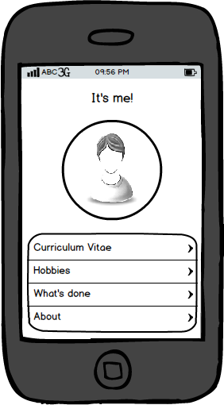
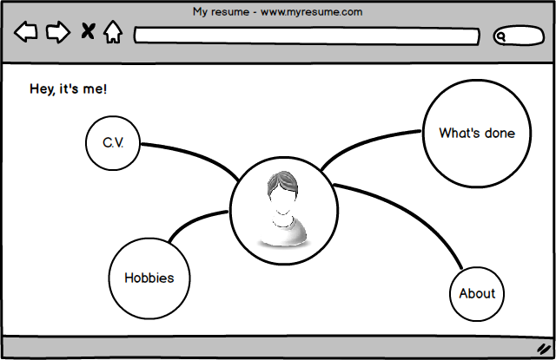
Exercise (2/3)
What is UI?
Example of index page:

Slide 29
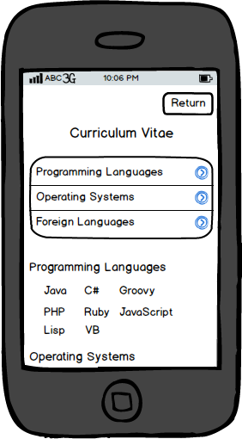
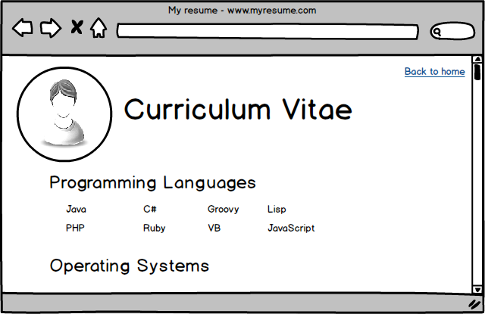
Exercise (3/3)
What is UI?
Example of C.V. page:

Slide 30
What IS uX?
User Experience

Slide 31
UX Definitions
What is UX?
“User experience (abbreviated as UX) is how a person feels when interfacing with a system.”
– Smashing Magazine
“The UX is everything that happens to your users when they interact with your business or organisation […]. It includes everything they see, hear and do as well as their emotional reactions.”
– What Users Do
Notes:
http://www.luminantdesign.com/definitions/userinterfacedesign.html

Slide 32
UX Explanation
What is UX?
User eXperience is:
More concerned about feelings
What’s behind and around User Interface
While UI is pretty, UX is usable
Makes a product unforgettable
Notes:
iPod examples (if any example comes in mind, don’t hesitate to tell)

Slide 33
UX Quote
What is UX?
[UX designers’] role is to tease out the brilliant idea that already exists inside the clients’ collective minds.
– Shane Morris, Interaction Designer
Notes:
Everyday UX – uxmastery.com

Slide 34
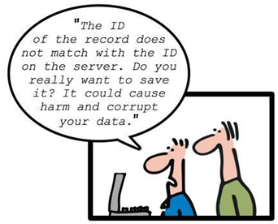
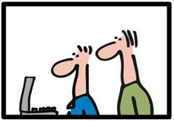
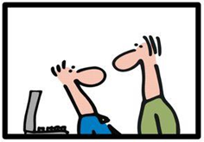
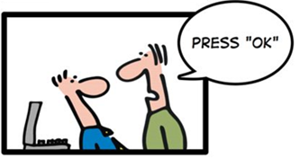

UX – ©Geek And Poke
What is UX?
Notes:
http://geekandpoke.typepad.com/geekandpoke/2010/12/geekpoke-about-ux.html

Slide 35
The UX Concerns
What is UX?
But UX is not just that!
It’s a complete process to give users an entire satisfaction of the tool. Might include:
Battery life, materials for devices
Loading time, typography for IT
…

Slide 36
Questions?

Slide 37
Question for you
What is UX?
Do you think Dailymotion has a great UX?
Are you fully satisfied of its use?
Which improvements could you think of?
Notes:
Debate!
~5min
Dailymotion is not a mandatory example, just a website almost everybody knows.

Slide 38

Diving into UX
User Experience

Slide 39
Introduction
Diving into UX
User-centered design depends on a great analyze
What user really wants? Who are they?
Need to put users’ shoes, be empathic
Design is really the last part of this analysis
Let’s take a website example

Slide 40
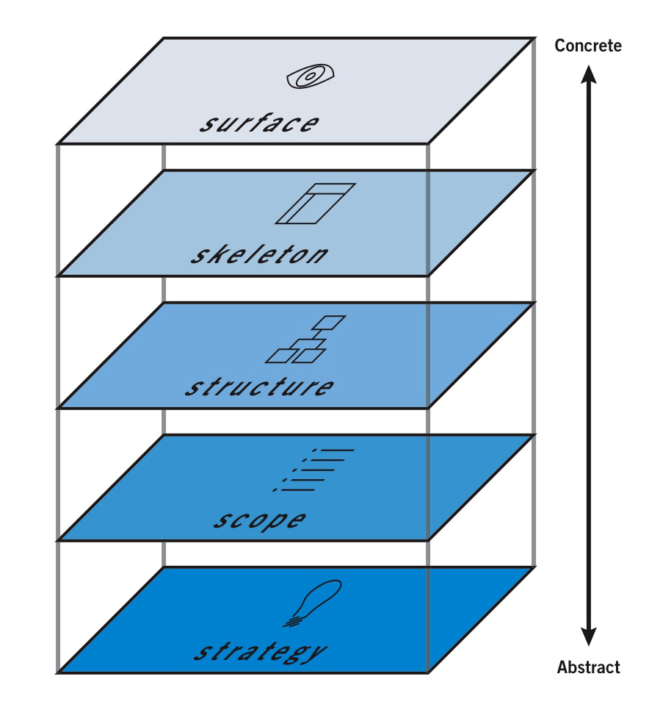
All begins with strategy
Diving into UX
Strategy
What we want
Sell products?
Inform?
Bring fun?
To whom?
Target your audience
Notes:
Image source : http://www.sccc.premiumdw.com/web202/the-user-experience/

Slide 41
All begins with strategy
Diving into UX
Strategy
What users need?
Stay focused on them
What others failed to do?
What users don’t need?
Trash useless steps/features
Notes:
Image source : http://www.sccc.premiumdw.com/web202/the-user-experience/

Slide 42
Then the scope
Diving into UX
Scope
Put features as a list
Ordered by importance
Remember, order is from users’ perspective
This is your checklist
Notes:
Image source : http://www.sccc.premiumdw.com/web202/the-user-experience/

Slide 43
After that, the structure
Diving into UX
Structure
The more important is a feature, the more it should be accessible in a simple way
Shortening workflows
All about user’s feelings
Notes:
Image source : http://www.sccc.premiumdw.com/web202/the-user-experience/
Do NOT forget to define workflows!
Here is a simple definition:
Workflows defines a list of steps linked each others to achieve a goal. Steps may be concurrent or wait for the previous one to finish. In an ecommerce website, the workflow « Buy a product » might take several steps, like « View a product », « Put it in the cart », « Go to the payment area », « Define the user (name, address, etc) », « Pay for the product », « Receive a bill now and the product later ».

Slide 44
After that, the structure
Diving into UX
Structure
Must be understandable
No labyrinthic connections
Must have a simple behavior
Each step must be « natural »
Neither design nor content
Notes:
Image source : http://www.sccc.premiumdw.com/web202/the-user-experience/

Slide 45
Before surface, skeleton
Diving into UX
Skeleton
First sketch of the website
How elements are placed?
Structure and Scope related
Stay user-centered
How they could react?
Notes:
Image source : http://www.sccc.premiumdw.com/web202/the-user-experience/
Skeleton is important to define where goes what, in which size etc.
There are no standard proportions to have, but think about where the user is going to look. More than that, where you want the user to look, without forcing him.

Slide 46
Surface in the end
Diving into UX
Surface
The final product, the UI
Just skinning the skeleton
Grab users’ eyes with design
Mandatory colors & shapes
But stay user-centered!
Notes:
Image source : http://www.sccc.premiumdw.com/web202/the-user-experience/
Mandatory colors and shapes :
Facebook (for example) must stay blue, with their specific « f ». Each functionnality must use the design scheme of the entire application in order to be coherent.
This obligation doesn’t mean to ignore the user behavior.

Slide 47
Questions?

Slide 48
Exercise (1/2)
Diving into UX
Case Study:
A nationally recognized football club wants to create a website for their fans and you asked to take care of the User Experience. Let’s borrow users’ shoes and think about an user-centered architecture.
Notes:
Average size of the football club : Bordeaux, Lille, …

Slide 49
Exercise (2/2)
Diving into UX
Take some time to think about what users want, then :
Write down the strategy
Define and write the scope
Organize and draw the structure
Sketch the skeleton of your website
The only needed tools are a pencil and sheets of paper.
Notes:
Average size of the football club : Bordeaux, Lille, …
Give papers back to the teacher in charge, he’ll do a general analysis about your work.

Slide 50
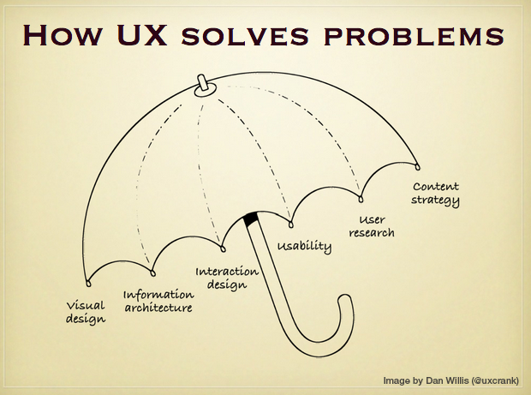
The UX Umbrella
Diving into UX
Notes:
This part has to be considered as a correction and a summary of previous slides
« The items that are sheltered by the umbrella have two purposeful omissions – user experience design and interface design.
User experience design is omitted because it is the loose term that encompasses all of the various disciplines. You’re never really doing any “user experience design” that isn’t just a combination of one or more of the things under the umbrella.
User interface design is omitted because it is the crossover between visual design (look and feel) and the interaction design (how the look and feel work). Combine those two and you have an interface. The interface is the result of the “solution design” that came before it.
A skillful interface designer understands the importance of providing the user with a solution to a defined problem. »
Source : http://www.helloerik.com/ux-is-not-ui

Slide 51
Visual Design
Diving into UX
How to display text
Size, typography, areas
Put link components at edge
Encourage user to navigate
Shapes and colors to grab user’s eyes

Slide 52
Information architecture
Diving into UX
Structure website
Already explained before
Make access to content easy and coherent

Slide 53
Interaction Design
Diving into UX
Design is just a layout to use functionnalities
User should interact easily with the website in order to reach its goal
Related to « Scope » part

Slide 54
Usability
Diving into UX
No guessing
All moves should be natural
Think about it:
No user should search something on the screen

Slide 55
User Research
Diving into UX
Who’s in front of your tool?
Go outside, meet them!
What do they need and want?
Create a tool without thinking of who can use it is going to fail

Slide 56
Content Strategy
Diving into UX
What users want to view and how
Media used, text, videos, …
Mandatory information
How it’s delivered
Loading time, easily found (SEO)
Why do they need these information?
Notes:
You’ll see SEO later in the year, in the Web Strategy course.

Slide 57
Let’s debate!
Diving into UX
Is right side better in examples?
Why?
Notes:
Open this picture :
http://www.toledo2.com/wp-content/uploads/2013/09/SideBySide.png
(If the link does not work, or for more information about it : http://www.toledo2.com/2013/09/17/nokia-partners-with-toledo-design-for-ui-design-reviews/ )
Take some of these examples depending of time left, and ask classroom differences between left and right, and why these changes are great for UX.

Slide 58
Questions?

Slide 59
Question for you
Diving into UX
Which brands are well-known for their good User Experience?
Notes:
Example of answer: Apple, Google, Coca, Sony

Slide 60

User Behaviors
User Experience

Slide 61

Introduction
User Behaviors
Many ways to learn from users:
Interviews
Beta-testing
Usability test
…
Not all are convenient depending on context

Slide 62

Interviews
User Behaviors
Step in users’ shoes and go outside
Meet websites creators and stakeholders
Set up small interviews
Gather data from:
Their experience
Your own experience
The project’s scope
Notes:
Interviews should be short, from 5 to 10 min

Slide 63
Interviews – Quote
User Behaviors
"I will identify who the key people are and get them all into a room and have a chat about what we’re trying to achieve. I then like to split them of into one-on-ones."
– Cameron Rogers, Head of User Experience at SEEK
Notes:
Interviews should be short, from 5 to 10 min

Slide 64

Beta test
User Behaviors
Open to many users
Analyze data gathered
Easiest way to try a product
Should be used with another insight
No first feedback
Misconception could occur at an earlier stage
Notes:
Misconception could occur at an earlier stage : For example, bad audience targetting might not be revealed by beta testing

Slide 65
Usability test
User Behaviors
Somebody testing the website
Ask what they understand with the home page
Ask to access to some information they could need
Ask what they feels about the website
Watch this video at home:
http://www.youtube.com/watch?v=QckIzHC99Xc
Notes:
Depending on campuses and time left, video might be viewed at home or in the course.
If viewed in the course, the most important part of this media is to figure out how the test is driven, not to watch every second.
Be concerned about how tests are driven, which questions are asked and the woman reaction.

Slide 66
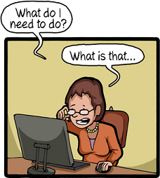
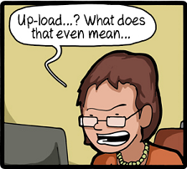
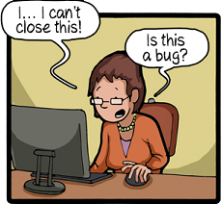
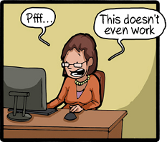
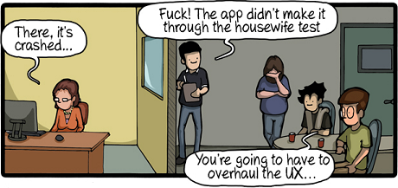
Usability test
User Behaviors
Notes:
Source: http://www.commitstrip.com/en/2014/01/13/le-test-le-plus-difficile-a-passer/

Slide 67
Other methods
User Behaviors
Do you have any idea of other testing methods usable?
Notes:
Example of answer:
Eye tracking
Softwares linked to a webcam
Looks eyes movements while browsing
Gather data from several users
Allows to emphase needed website parts
Example: myGaze Plugin for Morae 3.3
http://www.mygaze.com/products/morae-plugin/
Still pretty expensive and intrusive

Slide 68
Questions?

Slide 69
Good practices
User Experience

Slide 70
Imagin
Good Practices
Create little scenarios
Why/Where/When we use your product
Create little personas
Characters with feelings
Talk to users to get inspired
Why your product instead of the concurrent’s one?

Slide 71

Sketch!
Good Practices
Draw your designs and interactions
Usability > Design
If you’re not a good drawer, Balsamiq is for you!
http://balsamiq.com/

Slide 72
Using Balsamiq
Good practices
Demo
Notes:
For example:
http://www.awwwards.com/
http://www.sketchin.ch/en/
http://thenextweb.com
Source: http://socialdriver.com/2013/06/50-best-responsive-website-design-examples-of-2013/
Play with window size and explain advantages. It’s really important to talk about UI changes, how content disposition changes and why.

Slide 73
Small tips
Good Practices
Ask a lot of questions
There are no silly ones!
Wear someone else’s shoes
Understand their needs
Get away from the computer
Talk with representative users of the system
Notes:
UX Everyday - Tips

Slide 74
Small tips
Good Practices
Keep it usable
Beauty is important, but usability a lot more!
Never blindly copy
What works here might not work over there
You’re never 100% sure about UX results…
…Without testing it. So again, keep in touch with users!
Notes:
UX Everyday - Tips

Slide 75
Two great resources about UX
Good Practices
The UX wheel:
http://userexperienceproject.blogspot.fr/2007/04/user-experience-wheel.html
The UX spectrum:
http://themetaq.com/queue/spectrum-of-user-experience
Notes:
Case study example: http://www.pompage.net/traduction/experience-utilisateur-etude-de-cas

Slide 76
Questions?

Slide 77
Exercise
Good Practices
Take back the football club Case Study
Use all you saw to update it
Think about User Behaviors
Use Balsamiq to create mockups
Notes:
Take good examples and show them to classroom

Slide 78

The End
Powerpoint title
That’s all folks!

